Slide 1
Capstone Project
Bike Sharing Demand Prediction Team Members Manjusree K C Nivya T Harsh Jain Ammar Anjum

Slide 2

A bicycle-sharing system, bike share program, public bicycle scheme, or public bike share (PBS) scheme, is a shared transport service in which bicycles are made available for shared use to individuals on a short term basis for a price or free. Predicting bike sharing demand can help bike sharing companies to allocate bikes better and ensure a more sufficient circulation of bikes for customers.
Bike Sharing System

Slide 3

Problem Statement
Currently Rental bikes are introduced in many urban cities for the enhancement of mobility comfort. It is important to make the rental bike available and accessible to the public at the right time as it lessens the waiting time. Eventually, providing the city with a stable supply of rental bikes becomes a major concern. The crucial part is the prediction of bike count required at each hour for the stable supply of rental bikes.

Slide 4

Objectives 1. Prediction of bike count required at each hour for the stable supply of rental bikes in bike sharing system. 2. Gathering information regarding the factors that affect this prediction the most.

Slide 5
Steps Involved 1. Exploring the data: Analyzing the features and target variable, checking for null values and duplicates, plotting the distribution of target variable etc. 2. EDA: Treating numerical and categorical features separately, VIF Analysis, Encoding, Outlier detection etc. 3. Preprocessing of data: Train test split, Transformation, Scaling etc. 4.Creating models: Create different models and evaluate them using different metrics.

Slide 6
Data Summary
Data
Features
Target Variable
Numeric:
1.Hour
2.Temperature
3.Humidity
4.Wind speed
5.Visibility
6.Dew point temperature
7.Solar radiation
8.Rainfall
9.Snowfall
Categorical:
1.Season
2.Holiday
3.Functional Day
Rented bike count

Slide 7
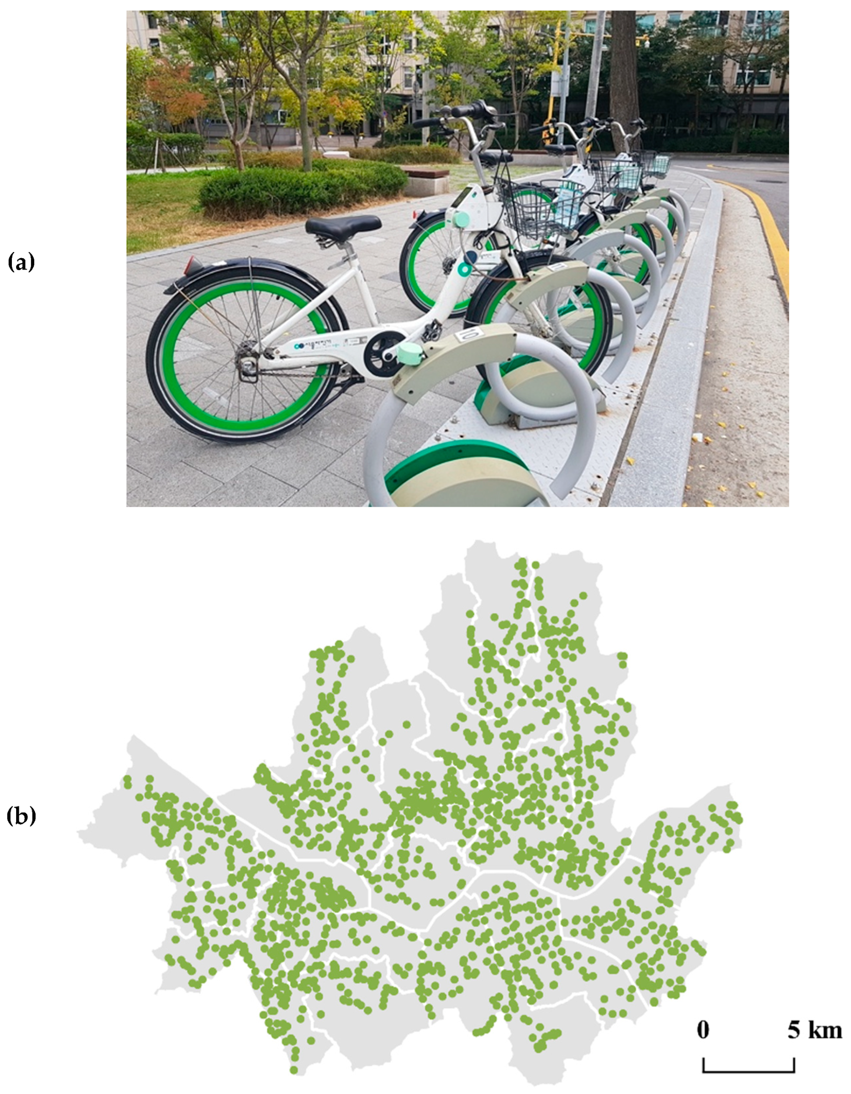
Define Dependent Variable In this project, the dependent variable is ‘Rented bike count’, the prediction of which gives us the exact number of bikes required per hour in order to reduce the waiting time.

Slide 8
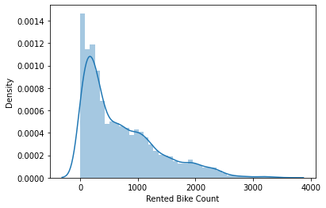
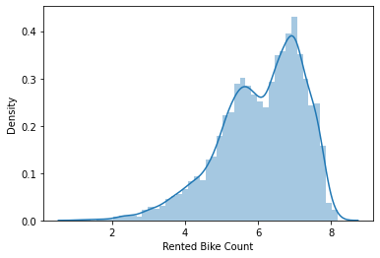
Plotting the distribution of dependent variable
The distribution of the dependent variable is skewed. Therefore we use log(1+x) transformation.

Slide 9
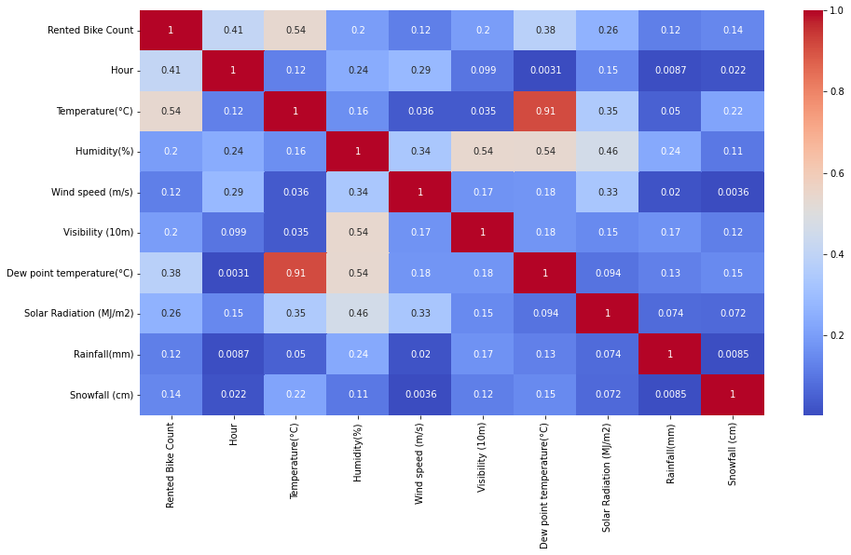
Collinearity Between Variables

Slide 10
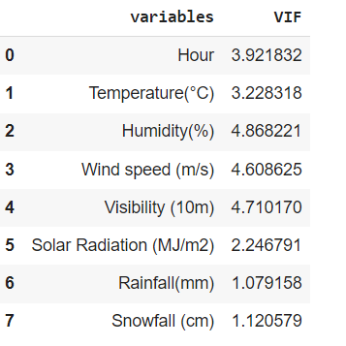

VIF Analysis
VIF is under 5 for all the variables. Therefore we can neglect the chances of multicollinearity.

Slide 11
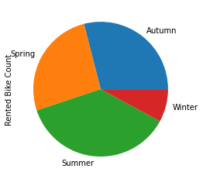
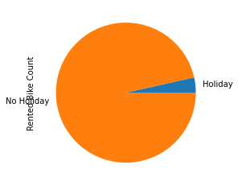
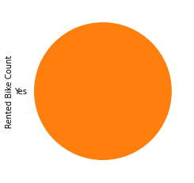
Bike Demand Based on Seasons, Holiday and Functioning Day

Slide 12
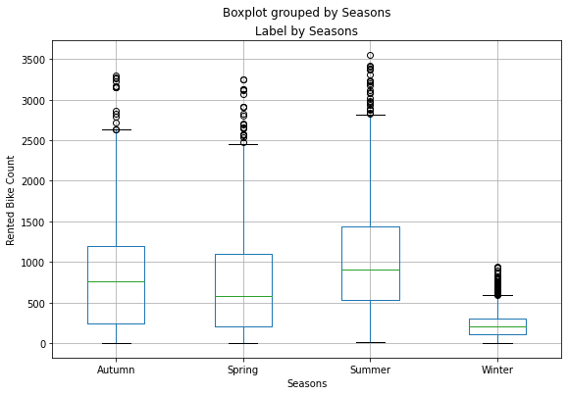
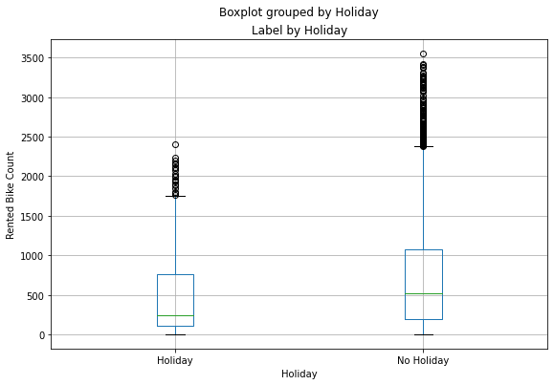
Outlier Detection: Box Plot

Slide 13
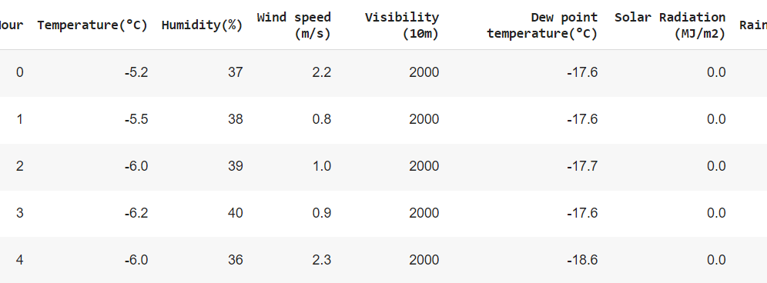

Preparing Dataset for Modelling
Task :Regression
Train Set :(7008, 11)
Test Set: : (1752,11)

Slide 14
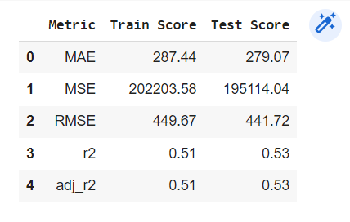
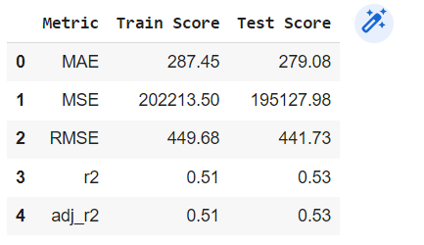
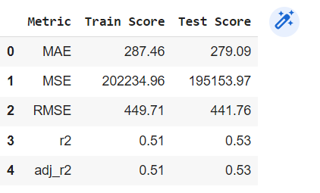
Linear Regression
The scores obtained while performing Linear Regression is:
ty
Lasso Regression
Ridge Regression

Slide 15
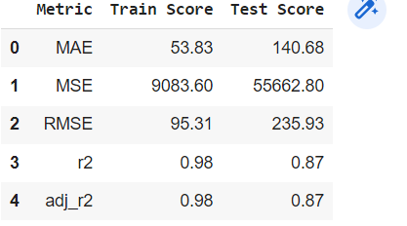
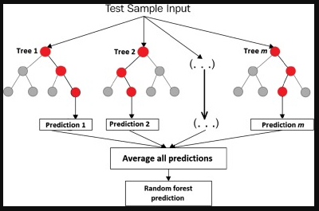
Random Forest
The scores obtained while performing Random Forest Regression is:

Slide 16
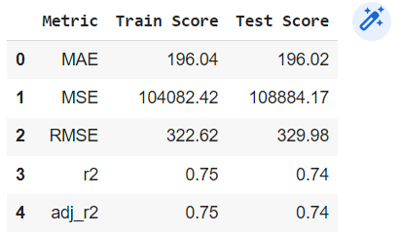
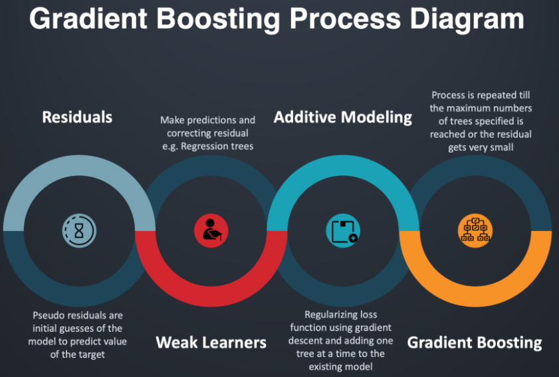
Gradient Boosting Machine
The scores obtained while performing Gradient Boosting Machine is:

Slide 17
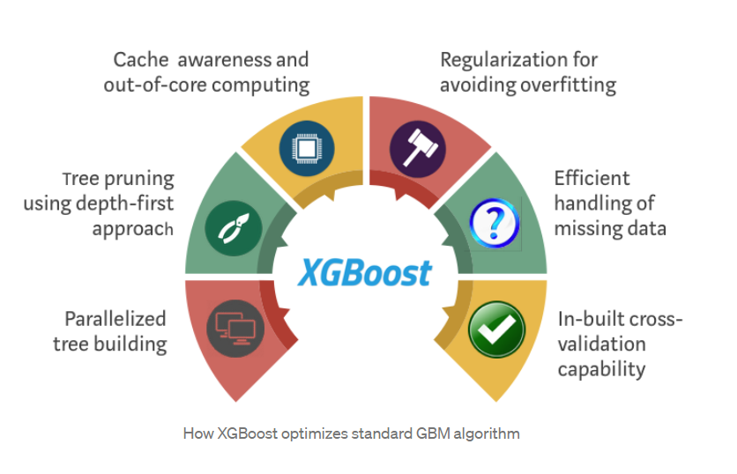
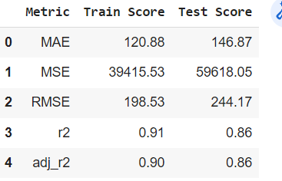
XGBoost
The scores obtained while performing XGBoost is:

Slide 18
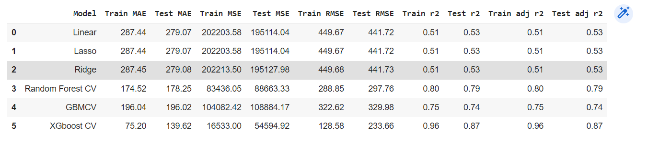
Scores After Cross Validation and Hyperparameter Tuning

Slide 19

Observations
Comparing the R2 score of all the models, one can see that XGBoost performs better.
R2 score in Linear Regression is 0.51 for the train data and 0.53 for the test data. Clearly, Linear Regression model fails in this case.
Random Forest has a test accuracy of 79% making it the second best model.
Gradient Boost Machine is also found to perform well on the data.

Slide 20
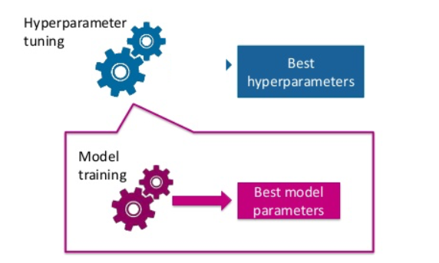
Best Parameters:
Random Forest:
max_depth’: 8
'min_samples_leaf': 40
'min_samples_split': 50
'n_estimators': 100
GBM:
max_depth=8
min_samples_leaf=40
min_samples_split=50
n_estimators=80
XGBoost:
'eval_metric': 'rmse’,
'max_depth': 6,
'n_estimators': 500,
'objective': 'reg:squarederror'

Slide 21
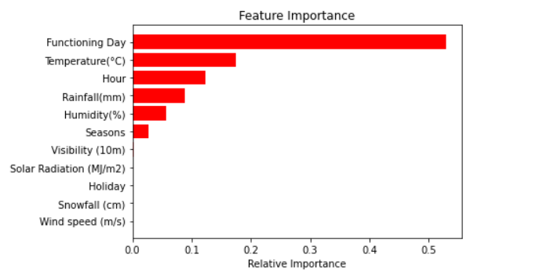
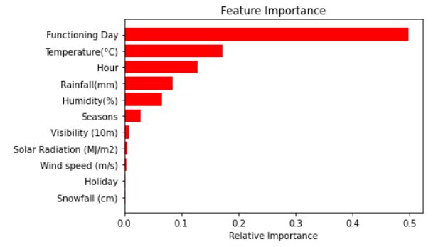
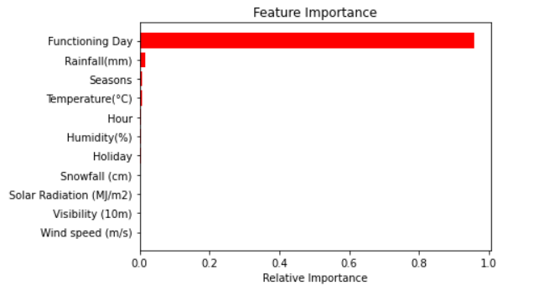
Feature Importance
Random Forest
GBM
XGBoost

Slide 22

Observations
The feature ‘Functioning Day’ has the highest impact on the dependent variable ‘Rented Bike Count’.
In Random Forest and GBM, ‘Temperature’ is making an impact while ‘Rainfall’ is the second most important factor in XGBoost.
Random Forest and GBM gives importance to 6-7 features while XGBoost considers only top 3-4 features and almost neglects the rest of the features.

Slide 23
Conclusion
This project focus on predicting the bike sharing demand using Seoul Dataset.
The results show that XGBoost, Random Forest and GBM algorithms perform well on the dataset whereas Linear Regression fails in this case. Among these three models XGBoost is found to have better performance.
Therefore XGBoost algorithm can be used as an effective tool for Bike Sharing Demand Prediction.
We did variable analysis in order to identify the hidden relationship between the variables. For all the models, functioning day, temperature and rainfall was ranked as the most influential variables to predict the rental bike demand at each hour.
This project identifies the curious relationship among the variables which can directly impact the dependent variable, ‘Rented Bike Count’.
This project will be helpful for the company to predict the hourly bike demand and enrich the user experience.
i9

Slide 24
Thank You

